Slide 1
Spring 2021
DATS 501 Fundamentals of Data Science
Hasan Demirtaş
hasan.demirtas@yeditepe.edu.tr (hdemirtas.academic@gmail.com)
Cumhur Baştürk
cbasturk.academic@gmail.com (basturkc@gmail.com)

Slide 2
Decision Theory

Slide 3
Idea
Minimizing the expected loss
Or
Maximizing the expected utility

Slide 4
Example1 (Minimizing the expected loss)
Electricity pole isolators length:
Loss function is linearly related with number of faults
Very long -> costly
Very short -> electric fault during rainy weather
Asssuming each fault costs 50-units money
 | Material cost | Fault | Fault cost | Total cost
Short | 100 | 5 | 250 | 350
Mid size | 200 | 1 | 50 | 250
Long | 300 | 0 | 0 | 300
Mid size is the plausible choice

Slide 5
Example2 (Maximizing the expected utility)
Investment in risky portfolios:
Loss function is square loss
Low risk -> low return & low bankrupt risk
High risk -> high return & high bankrupt risk
Asssuming bankrupt costs 1000-units money
 | Return | Bankrupt prob. | Bankrupt cost | Bankrupt utility | Total utility
Low risk | 100 | 0% | 0 | -0 | 100
Mid risk | 200 | 2% | 20 | -400 | -200
High risk | 300 | 3% | 30 | -900 | -600
Low risk is the plausible choice

Slide 6
Example3 (cost matrix for classification)
Spam classification:
y = 0 is not spam, y = 1 is spam
ŷ = 0 is not spam predicted, ŷ = 1 is spam predicted
utility | y = 0 | y = 1
ŷ = 0 | 1 | -10
ŷ = 1 | -100 | 2

Slide 7
Example4 (cost function for linear regression)
Deviation from real value penalty:
Loss function is order 2
y is the real target value
ŷ is the predicted target value
L = ( y – ŷ )^2

Slide 8
Cognitive Biases

Slide 9
Framing Effect
How information is framed (shown) affects our choices
Positive expressions are more effective on average human

Slide 10
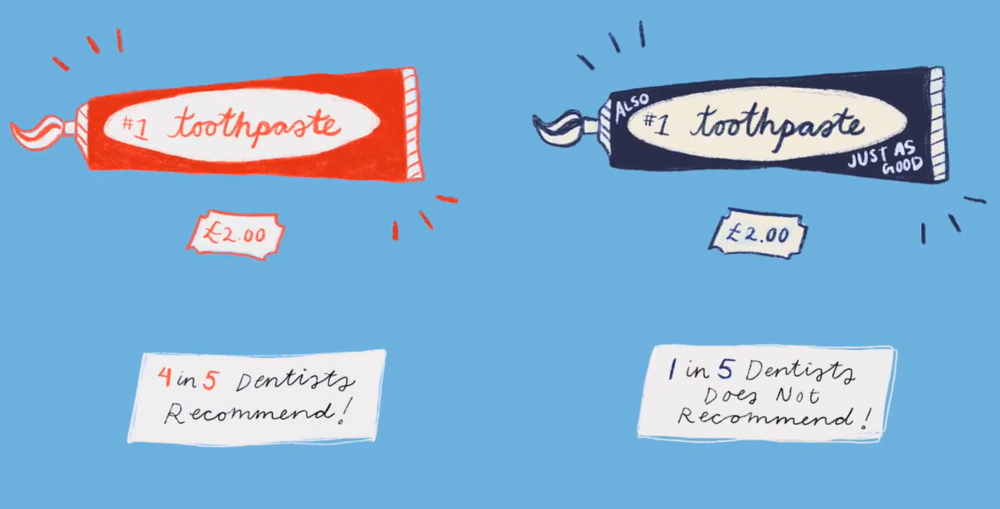
Framing Effect
Advertisements generally focus on positive expressions

Slide 11
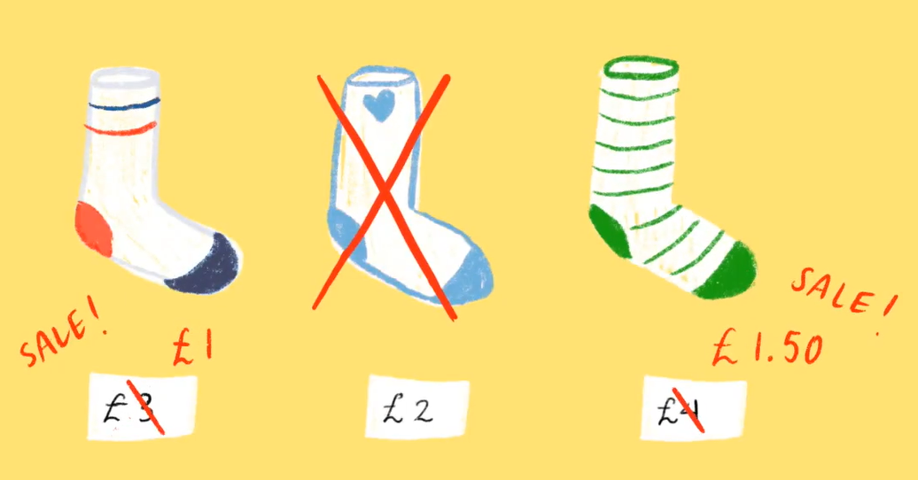
Framing Effect
Advertisements generally focus on positive expressions

Slide 12
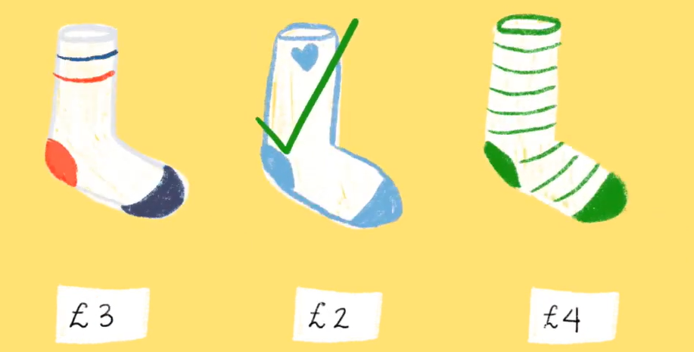
Framing Effect
Advertisements generally focus on positive expressions

Slide 13
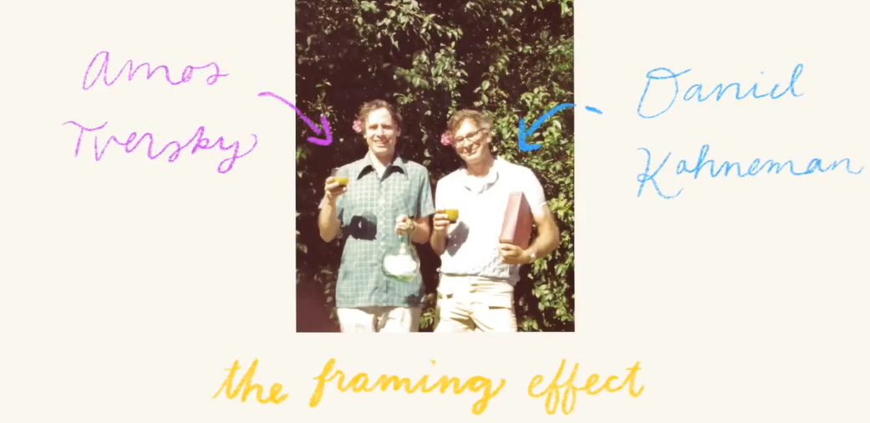
Framing Effect
Tversky & Kahneman

Slide 14
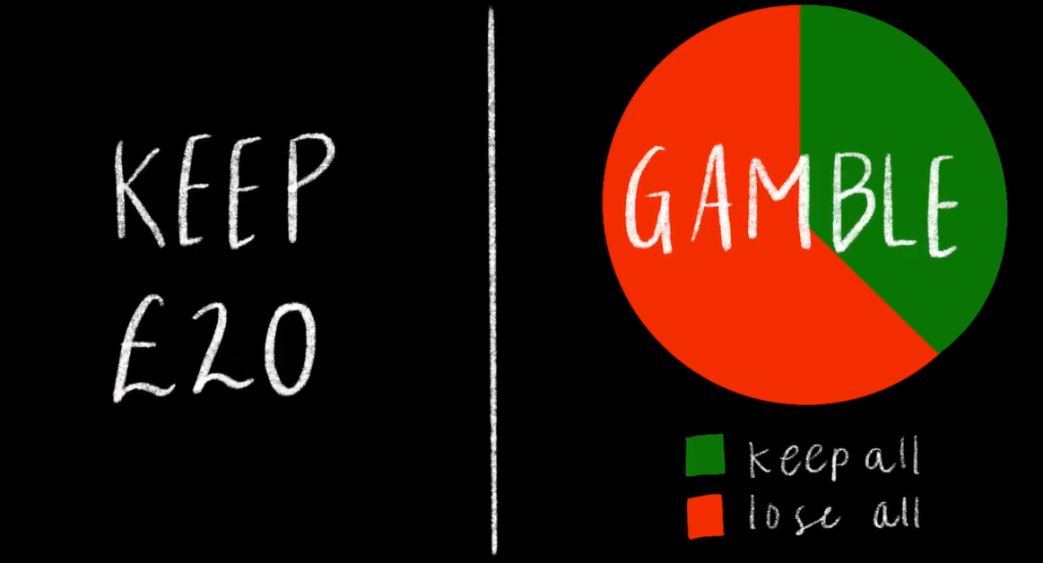
Framing Effect
You receive 50 euros

Slide 15
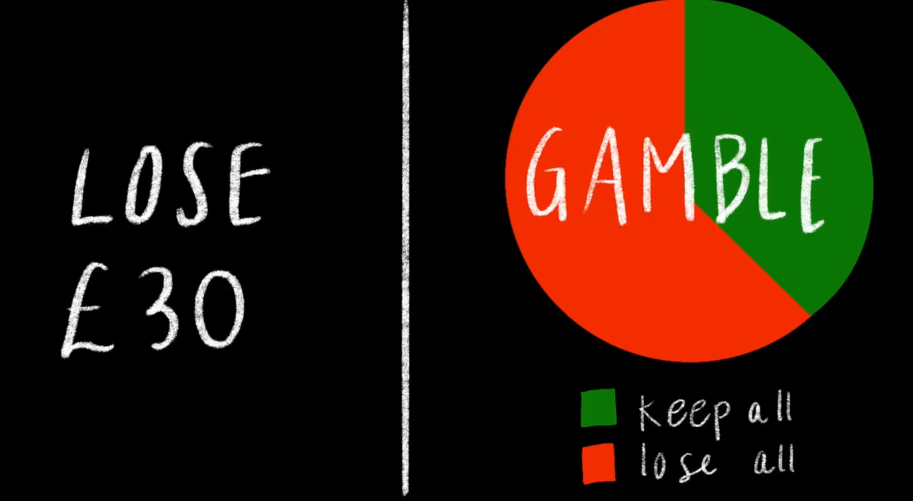
Framing Effect
You receive 50 euros

Slide 16
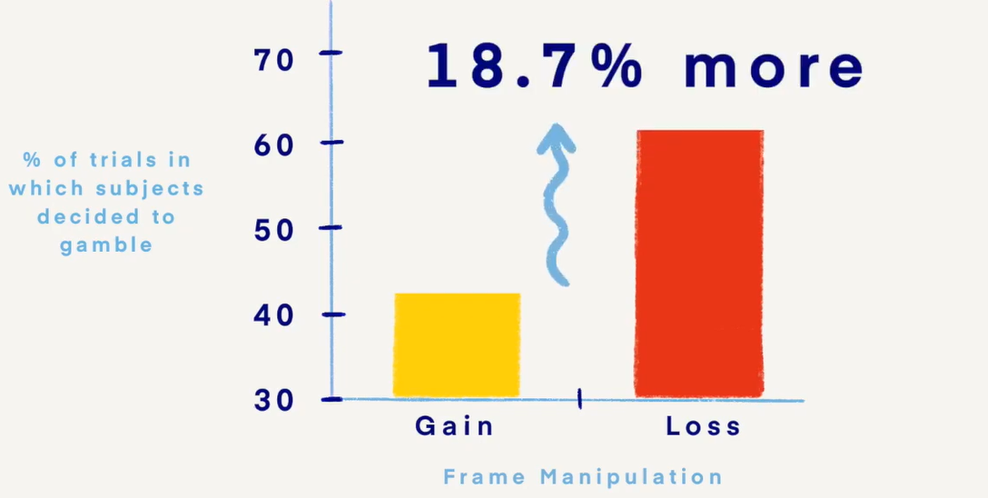
Framing Effect
Choice comparison

Slide 17
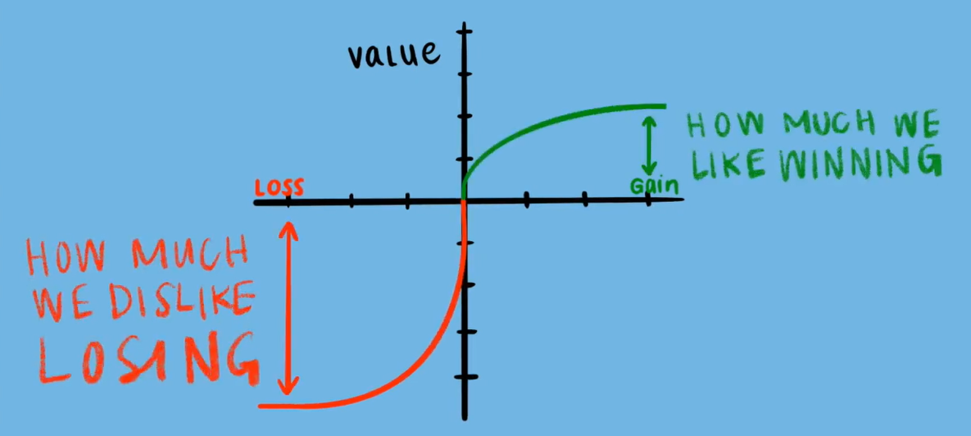
Framing Effect
Risk avert

Slide 18
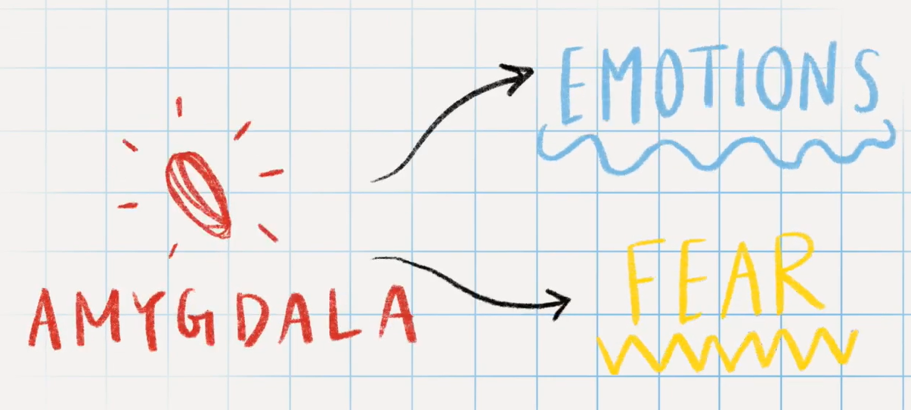
Framing Effect
Brain

Slide 19
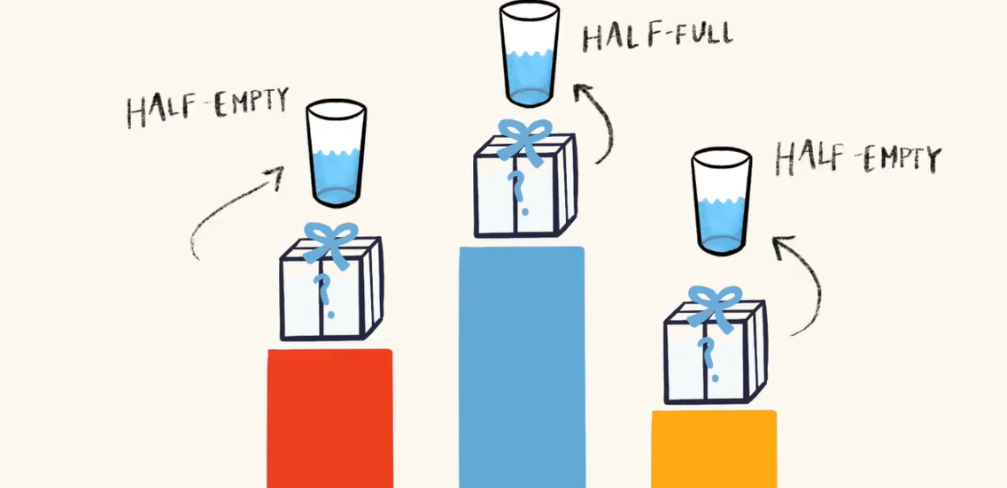
Framing Effect
Winner is the positive

Slide 20
Endowment Effect
How information is framed (shown) affects our choices
Positive expressions are more effective on average human

Slide 21
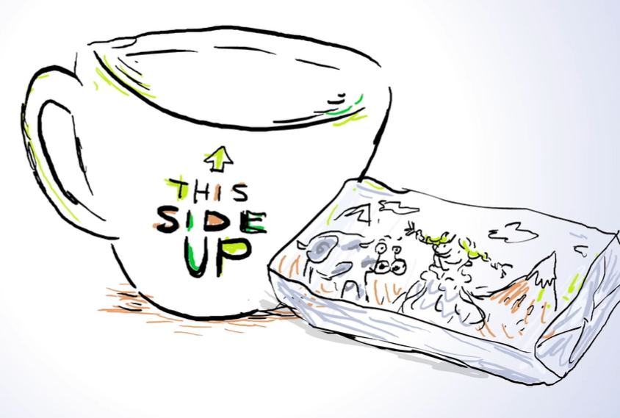
Endowment Effect
Students were asked to choose between a coffe mug and chocolate bar for helping a science experiment

Slide 22
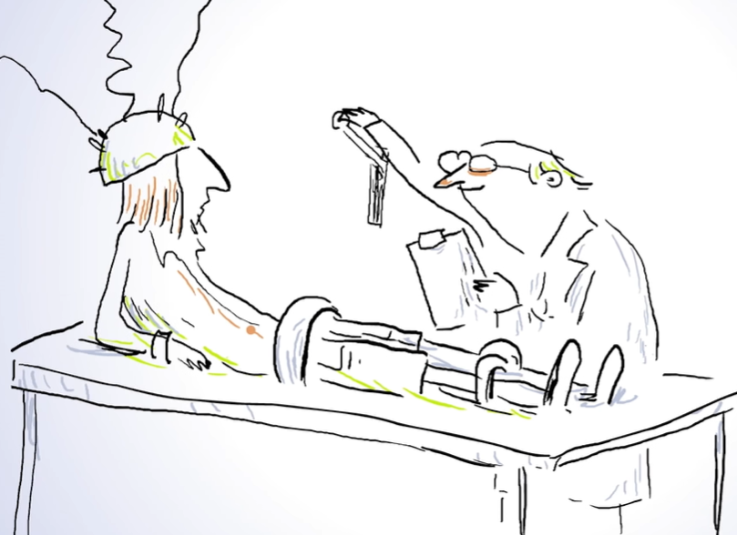
Endowment Effect
Students were asked to choose between a coffe mug and chocolate bar for helping a science experiment

Slide 23
Endowment Effect
A group of students were asked to choose between a coffe mug and chocolate bar for helping a science experiment

Slide 24
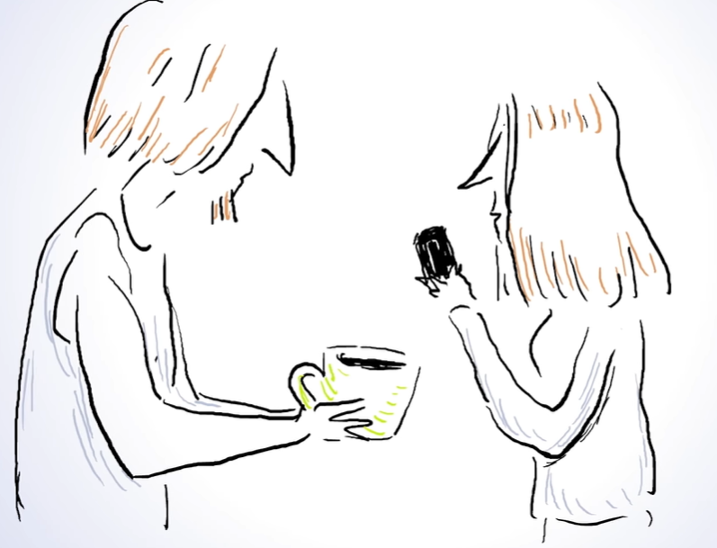
Endowment Effect
Half chosed the mug, half chosed the bar -> They valued the items similarly

Slide 25
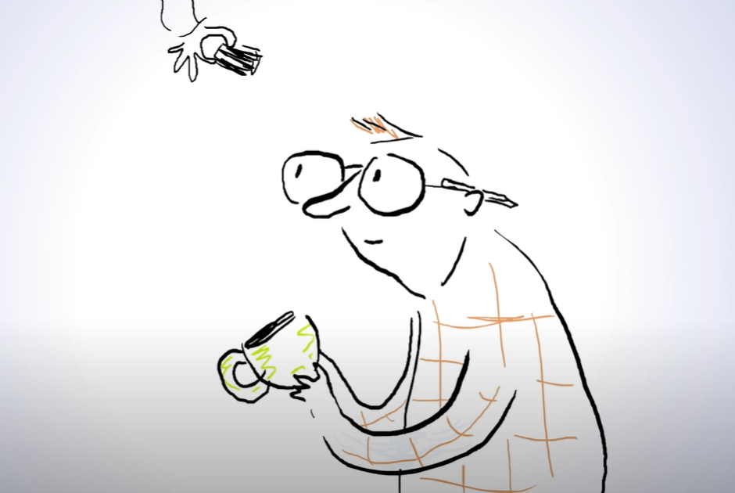
Endowment Effect
Some other group of students were given a mug first and chance to swap it for a chocolate bar

Slide 26
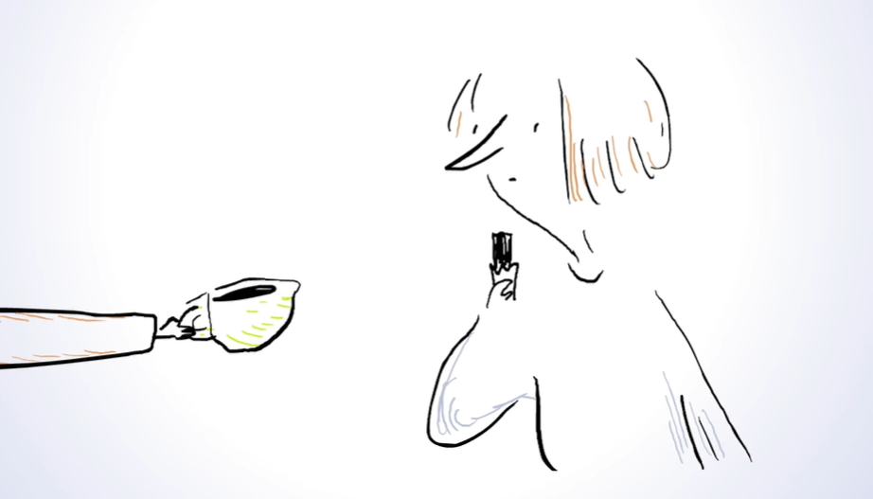
Endowment Effect
Same is done for chocolate bar also

Slide 27
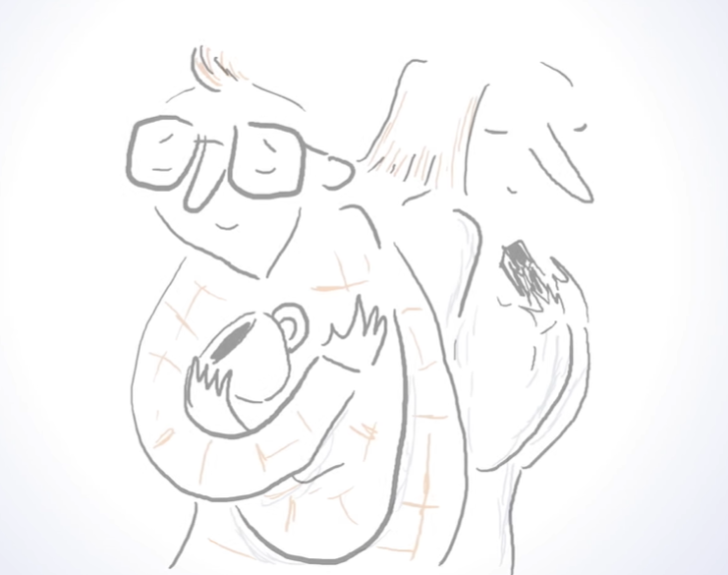
Endowment Effect
They mostly have chosen to keep the initial choice

Slide 28
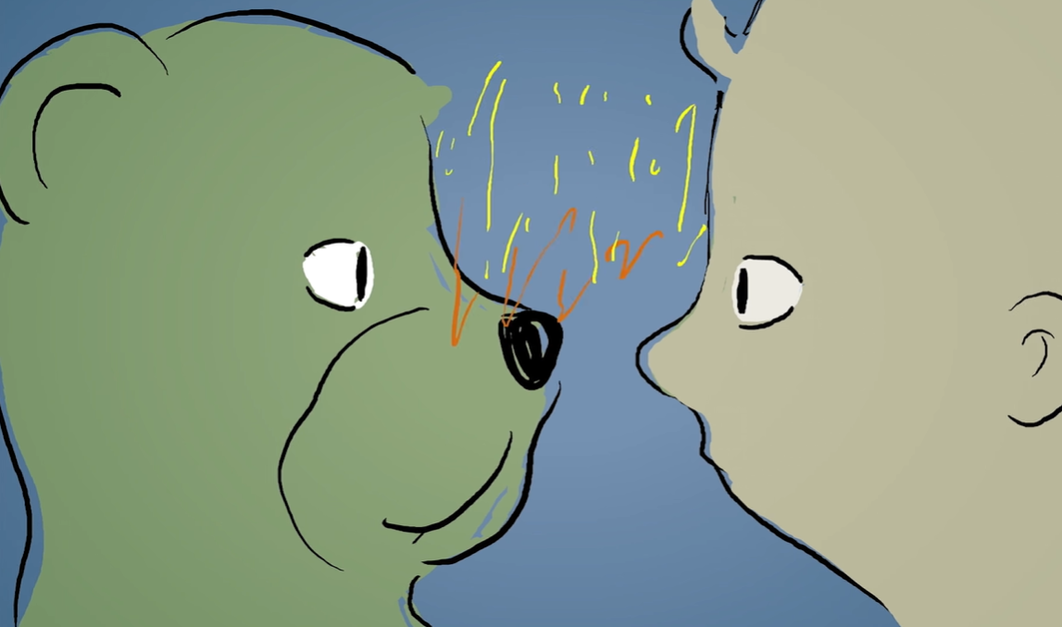
Endowment Effect
We quickly form connection at neural level

Slide 29
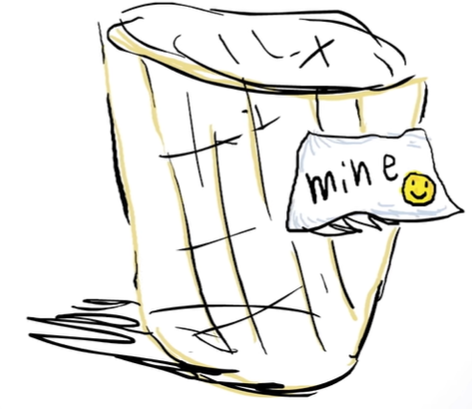
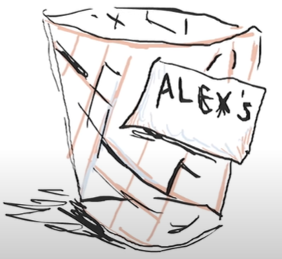
Endowment Effect
Even a single label affects our perception

Slide 30
Endowment Effect
Even a single label affects our perception

Slide 31

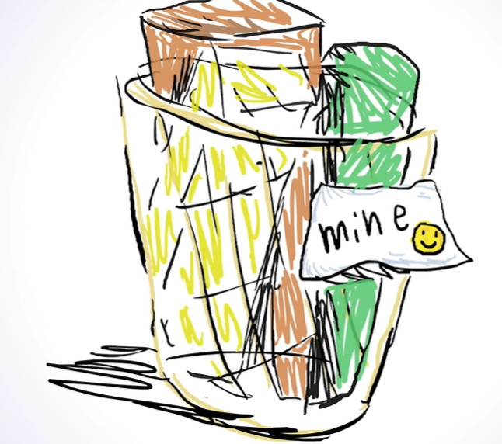
Endowment Effect
Putting items in the basket activates our brain

Slide 32
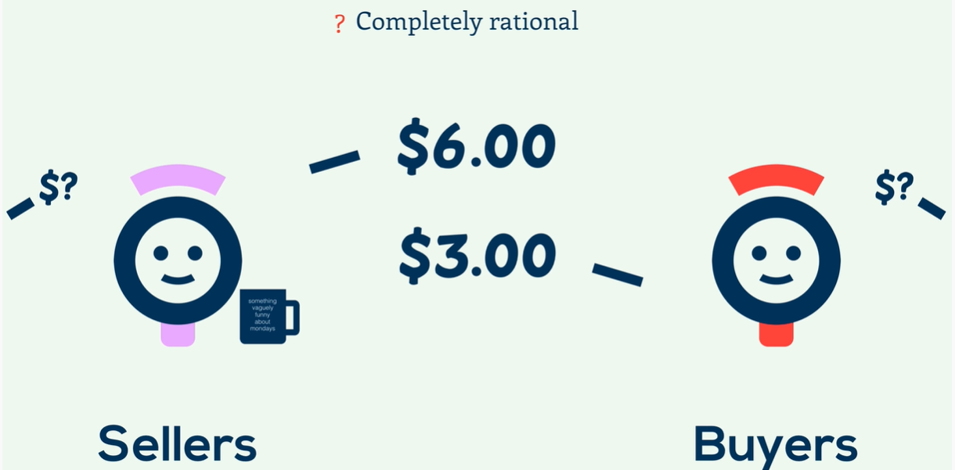
Endowment Effect
Sellers vs Buyers

Slide 33
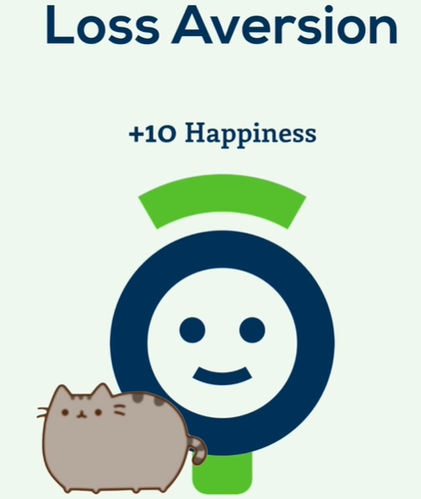
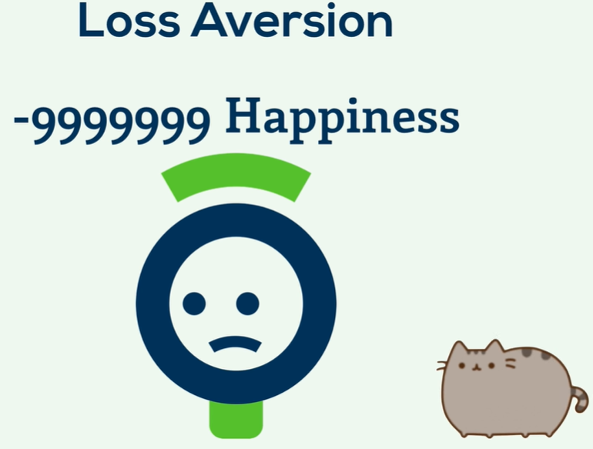
Endowment Effect
Loss aversion nature

Slide 34
Endowment Effect
Loss aversion nature

Slide 35

Endowment Effect
Marketing: Trial rooms, free trials, free samples

Slide 36



Endowment Effect
Accepting new tech and leaving legacy may be challenging

Slide 37
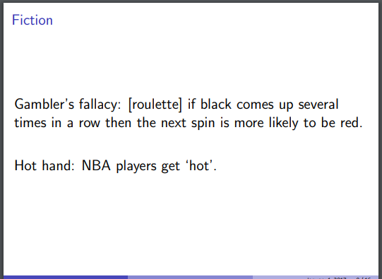
Gambler’s fallacy
A bias example

Slide 38
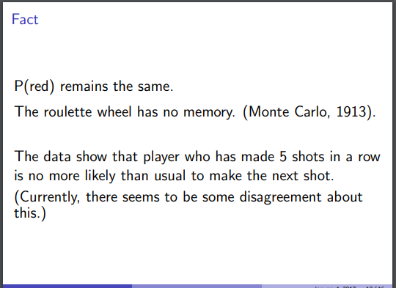
Gambler’s fallacy
A bias example

Slide 39
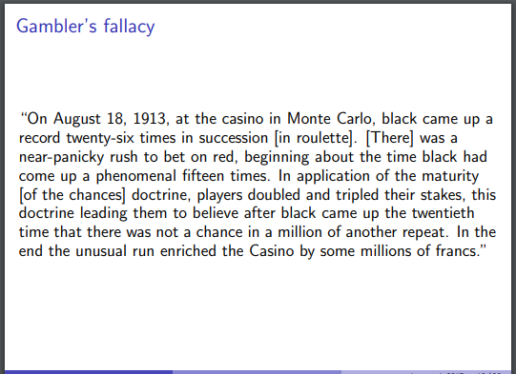
Gambler’s fallacy
A bias example

Slide 40
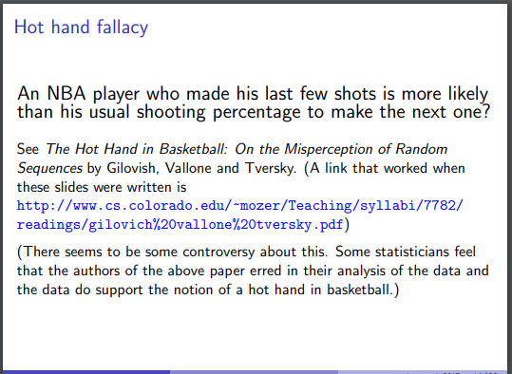
Gambler’s fallacy
Hot hand fallacy is like Gambler’s fallacy

